Slide 1
Welcome
Northwest Satellite Transportation Facility
Neighborhood Meeting
November 19, 2009

Slide 2


Our purpose today
To present our plan and to seek Community support
Meeting the needs of our Community
November 19, 2009

Slide 3
Discussion Topics
Land Acquisition Update
Overall Site Plan
Engineering
Transportation
Q&A
- Linda K. Perri
Director, CCSD Real Property Management
- James C. Lord II, AIA
KGA Architecture
- Vernon Harkins, P.E.
L.R. Nelson Consulting Engineers, Inc.
- Frank C. Giordano
Director, CCSD Transportation
- Linda K. Perri
Director, CCSD Real Property Management
NORTHWEST SATELLITE TRANSPORTATION FACILITY
Discussion Topics

Slide 4
Land Acquisition Update
Linda Perri

Slide 5
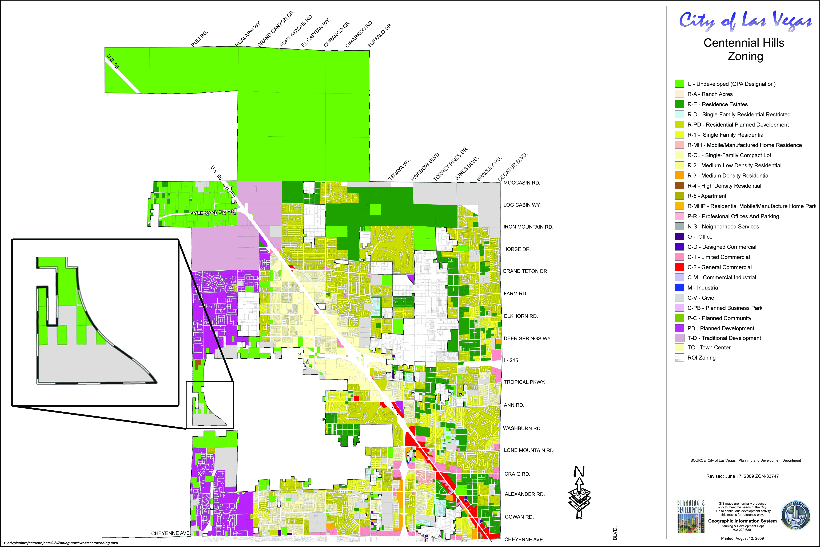
NORTHWEST SATELLITE TRANSPORTATION FACILITY
CENTENNIAL HILLS ZONING

Slide 6
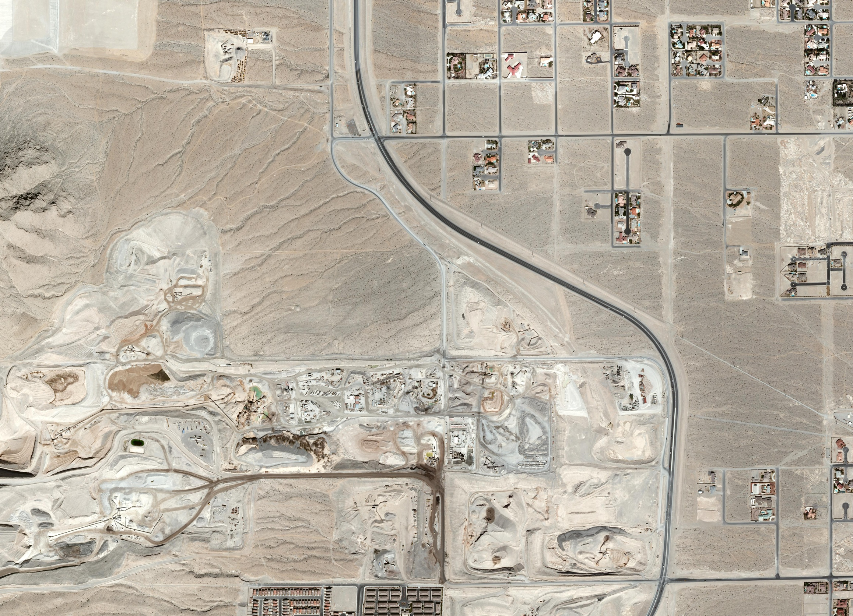
R-F
APLINE
ROAD
EGAN
CREST DR
HUALAPAI
WAY
U (PCD)
ANN ROAD
R-U
R-U
R-E
APLINE RIDGE WAY
215 BELTWAY
C-V Civic
SITE
WASHBURN ROAD
R-U
U (PCD)
R-F
LONE MOUNTAIN ROAD
PD
C-V Civic
NORTHWEST SATELLITE TRANSPORTATION FACILITY
CURRENT AERIAL VIEW

Slide 7
RPM – BLM Process
Identify Requested Parcel
Submit application to BLM
BLM Process
Obtain Patent
30-day NEPA process
Obtain Joint Selection Letter from appropriate Jurisdiction
RPM determines need to acquire BLM owned parcels
EA process (site inspection)
REQUEST PATENT
(Upon Project Completion)
US Government retains Reversionary Rights
Size
Suitability
Obtain Concurrence Letter from State of Nevada
NORA requirement (local paper 3 wks)
Availability
FONSI
Decision Record
Lease Granted
Notes:
NEPA - NATIONAL ENVIRONMENTAL POLICY ACT
EA - ENVIRONMENTAL ASSESSMENT
NORA - NOTICE OF REALTY ACTION
FONSI - FINDING OF NO SIGNIFICANT IMPACT

Slide 8
Overall Site Plan
James C. Lord II, AIA

Slide 9
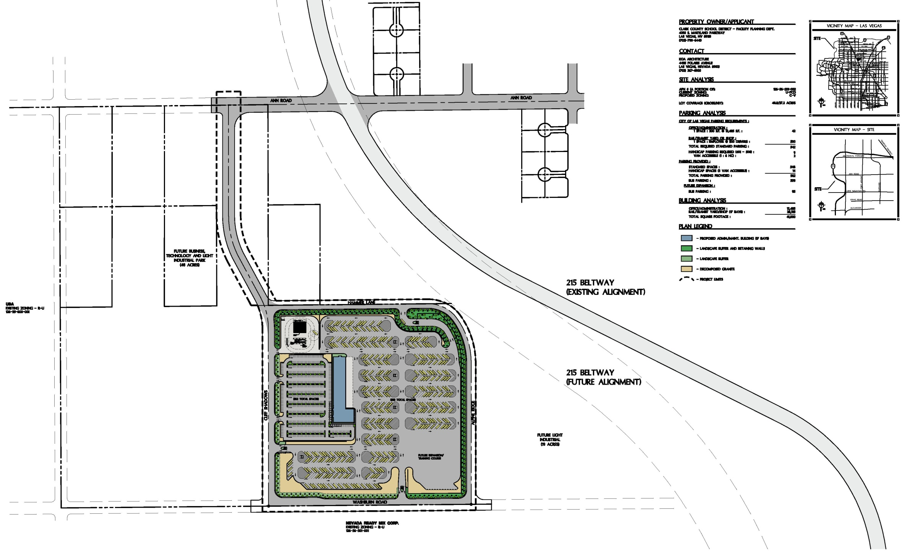
Site Plan
NORTHWEST SATELLITE TRANSPORTATION FACILITY
OVERALL EXISTING SITE PLAN

Slide 10
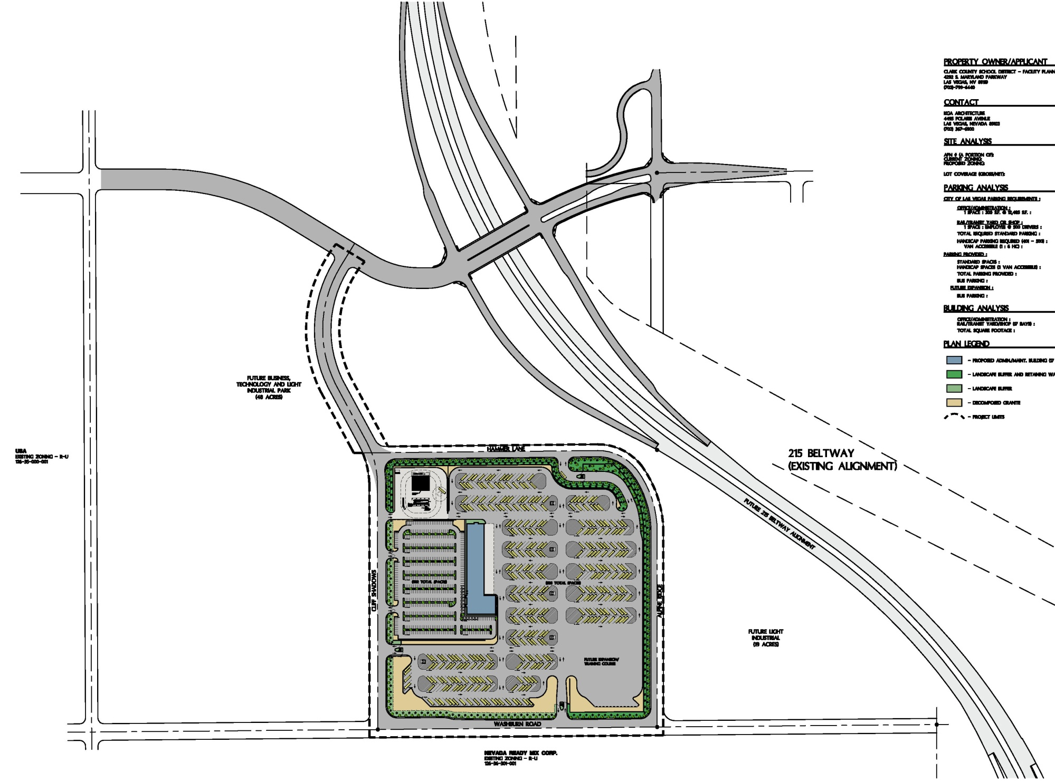
Site Plan
NORTHWEST SATELLITE TRANSPORTATION FACILITY
OVERALL FUTURE SITE PLAN

Slide 11
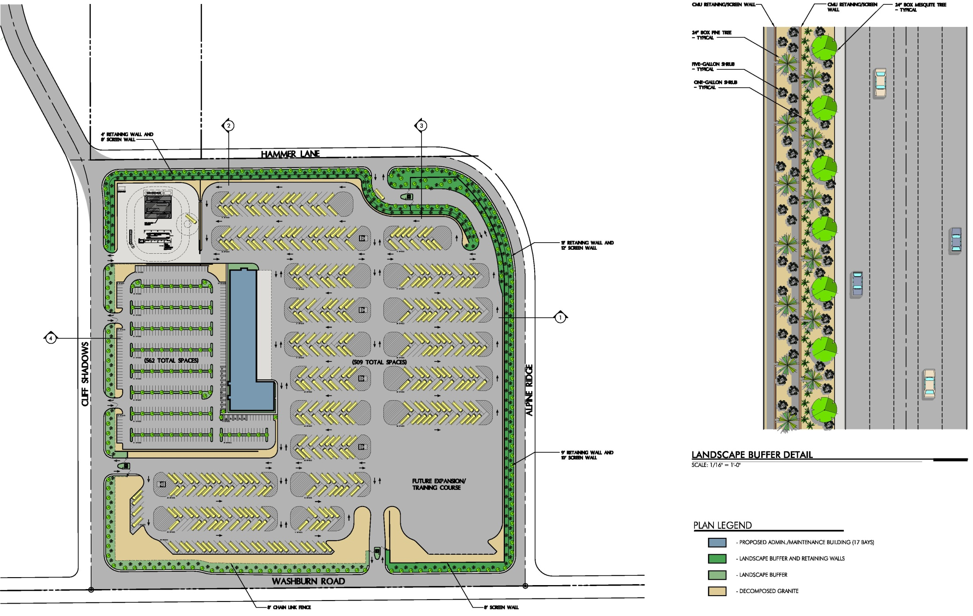
NORTHWEST SATELLITE TRANSPORTATION FACILITY
OVERALL LANDSCAPE PLAN

Slide 12
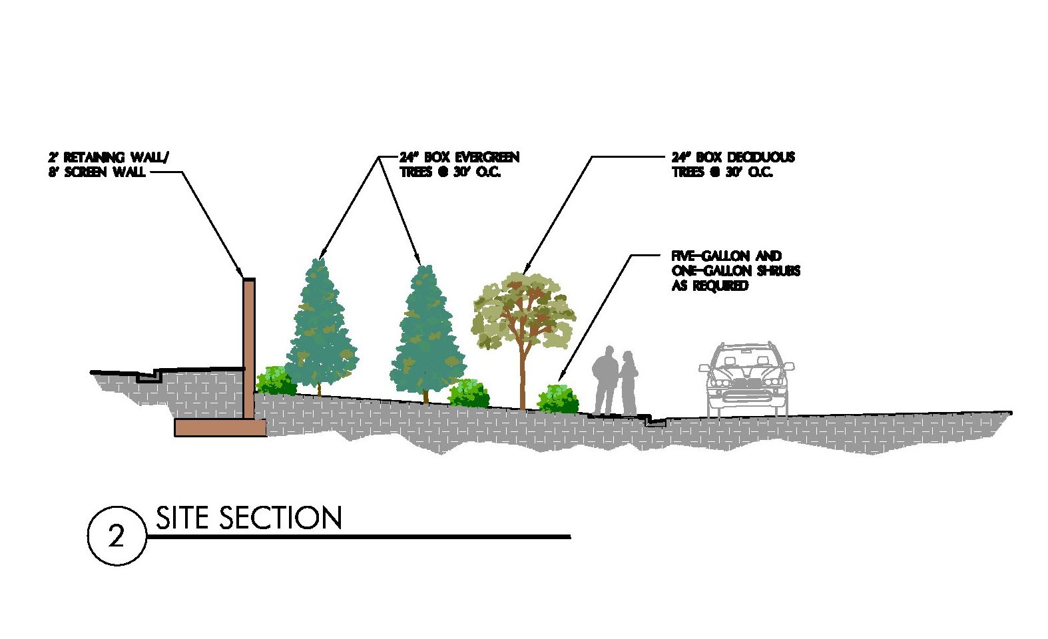
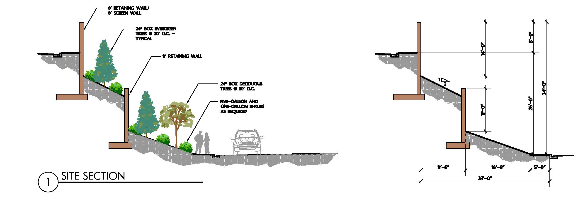
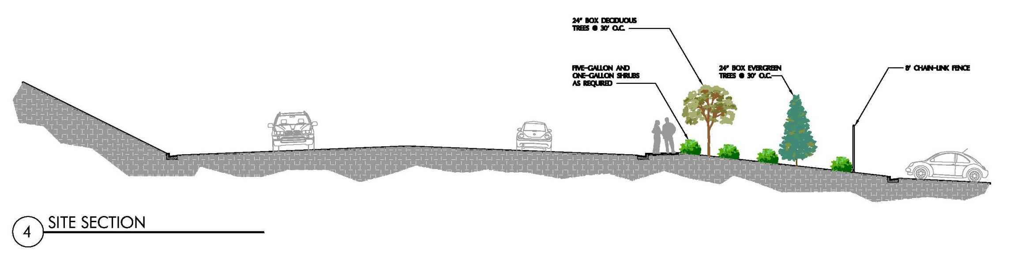
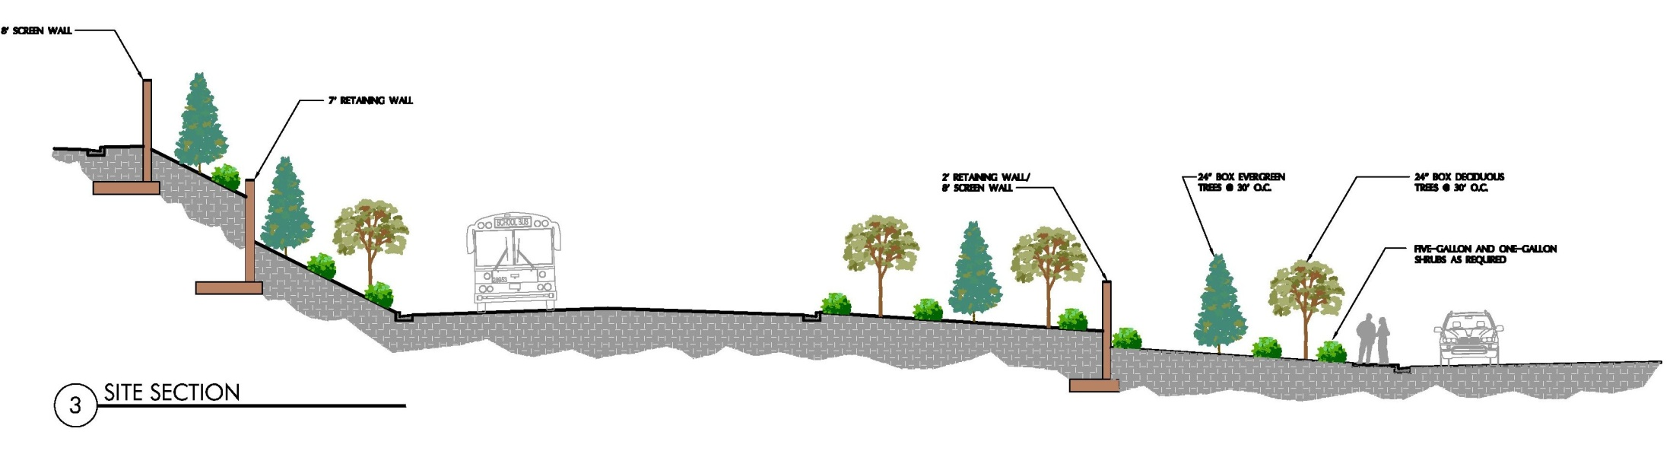
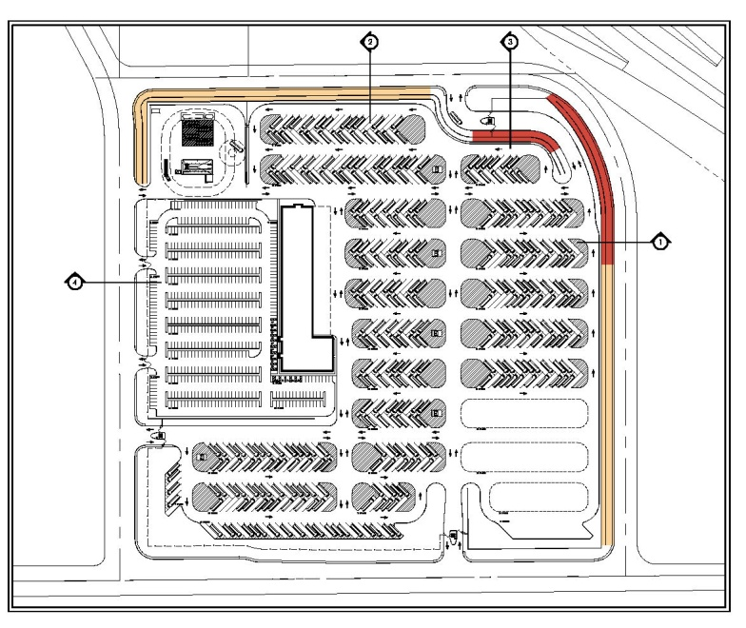
NORTHWEST SATELLITE TRANSPORTATION FACILITY
SITE SECTIONS

Slide 13
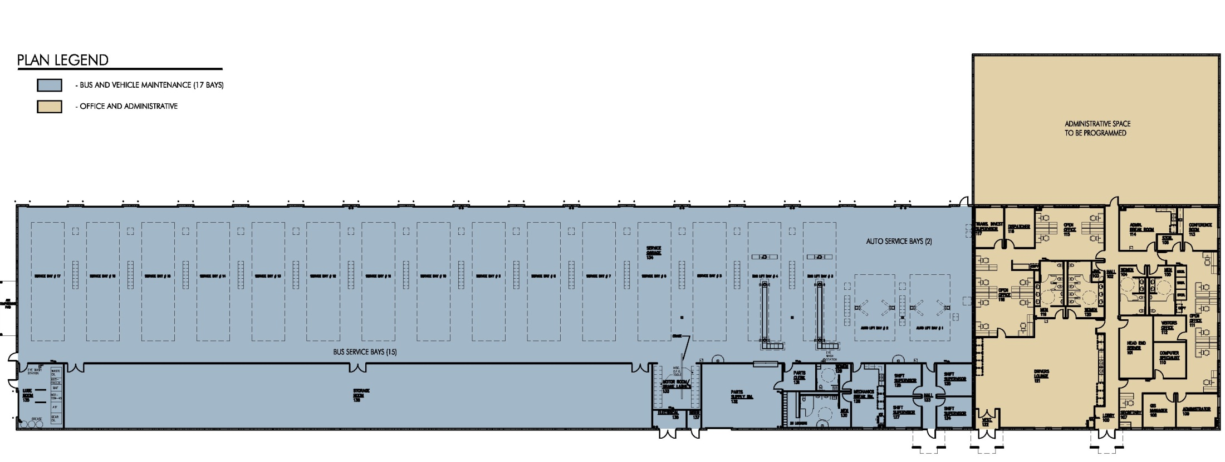
NORTHWEST SATELLITE TRANSPORTATION FACILITY
MAINTENANCE BUILDING FLOOR PLAN - 41,000 S.F.

Slide 14
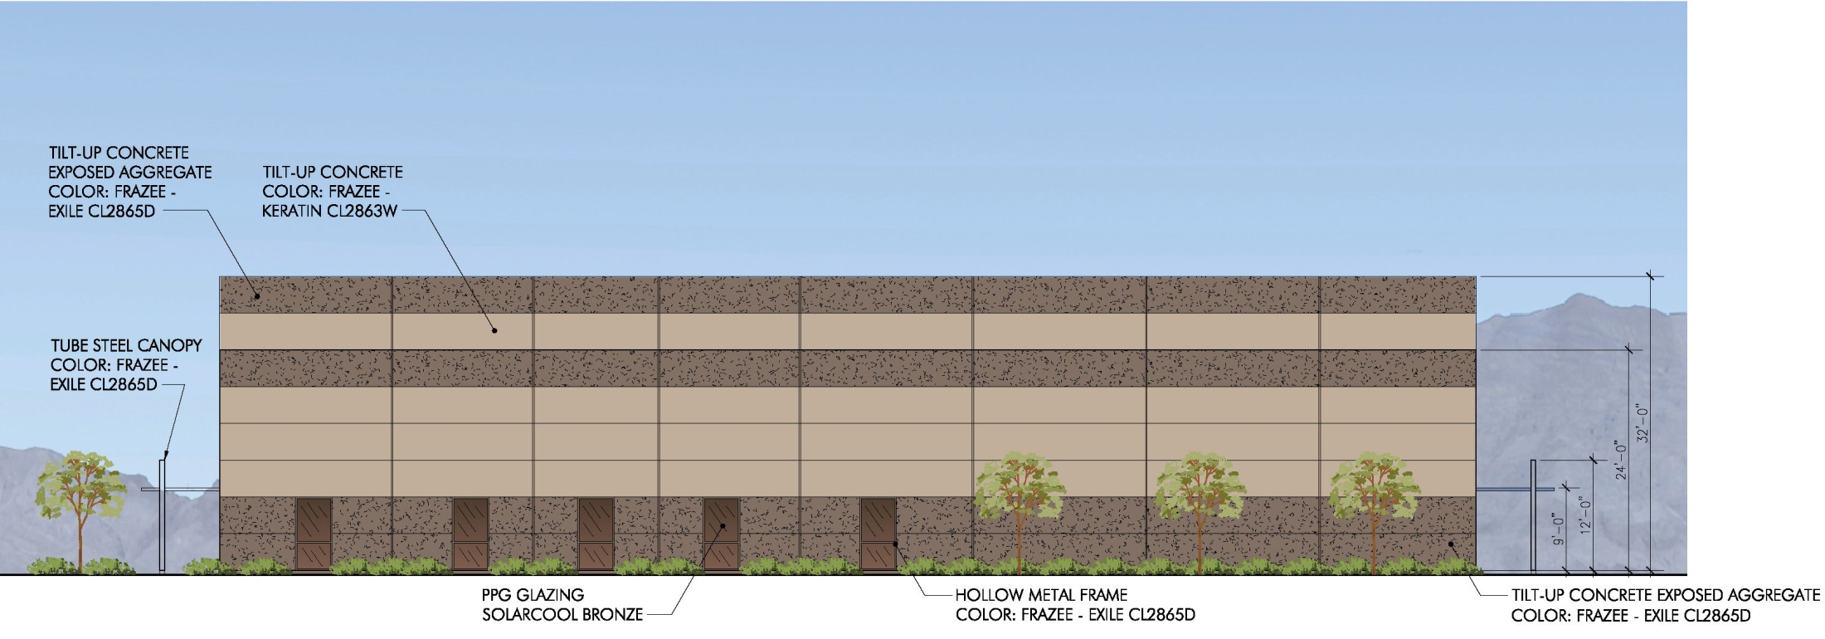
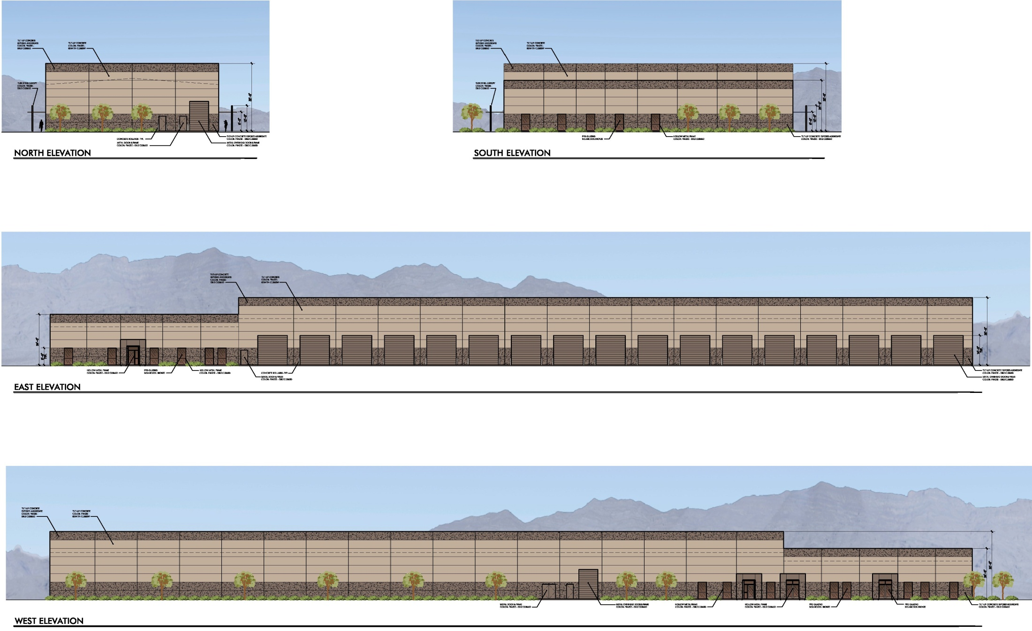
NORTHWEST SATELLITE TRANSPORTATION FACILITY
MAINTENANCE BUILDING EXTERIOR ELEVATIONS

Slide 15
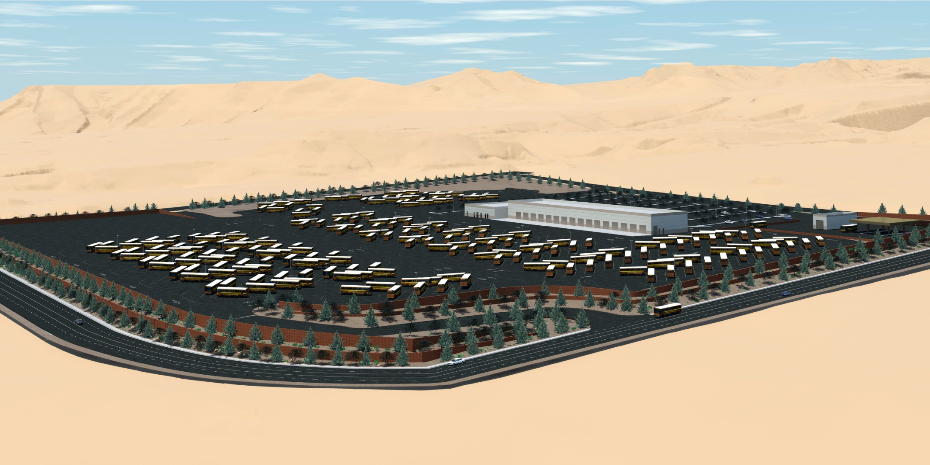
NORTHWEST SATELLITE TRANSPORTATION FACILITY
AERIAL VIEW - RENDERING FROM THE NORTHEAST

Slide 16
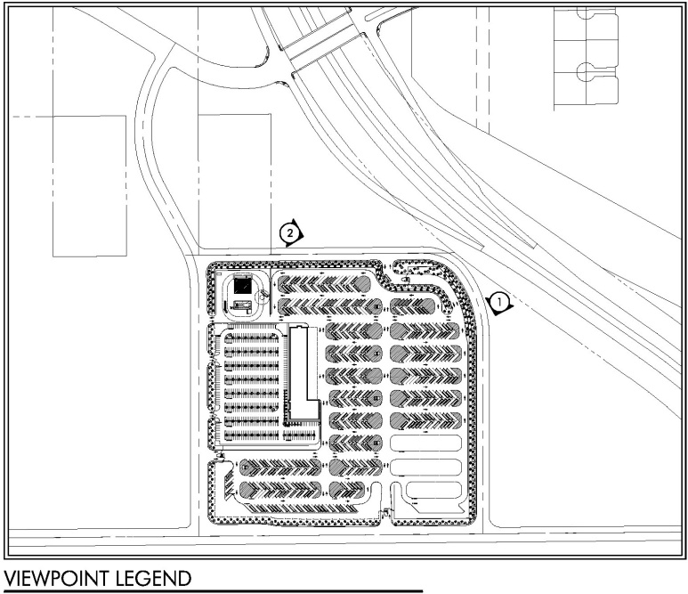
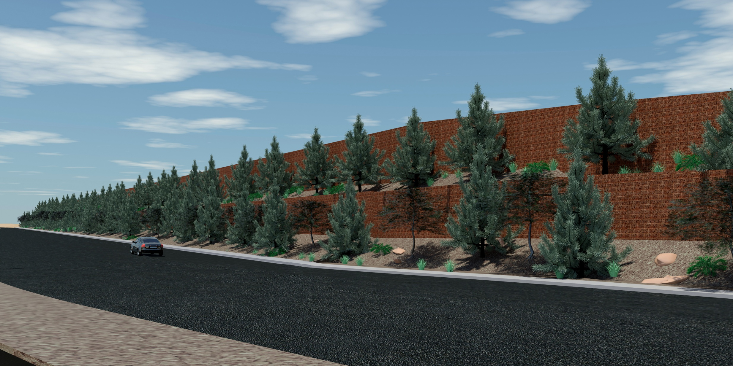
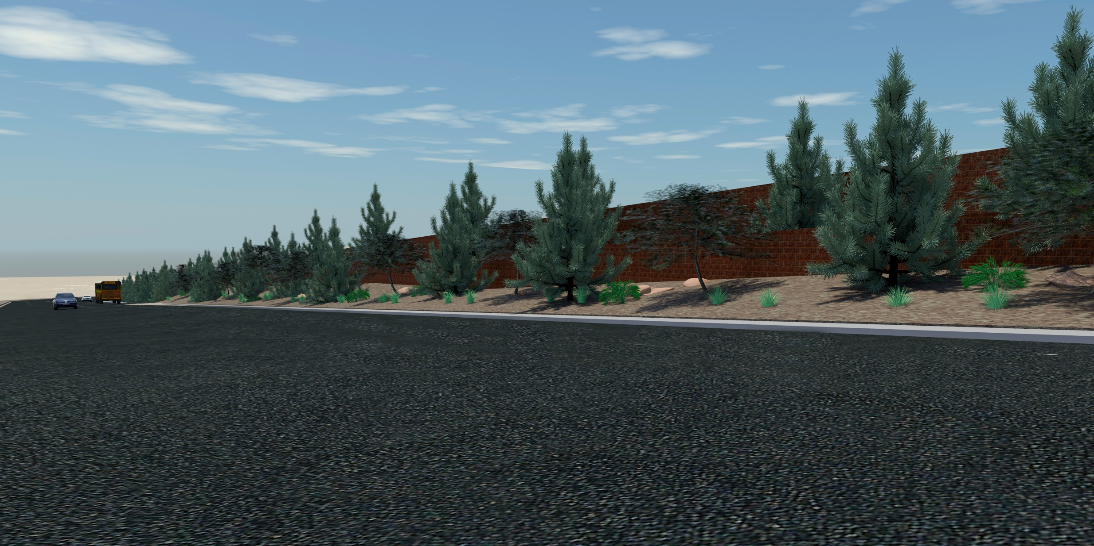
Site Perimeter Renderings
2
1
NORTHWEST SATELLITE TRANSPORTATION FACILITY
SITE PERIMETER RENDERINGS

Slide 17
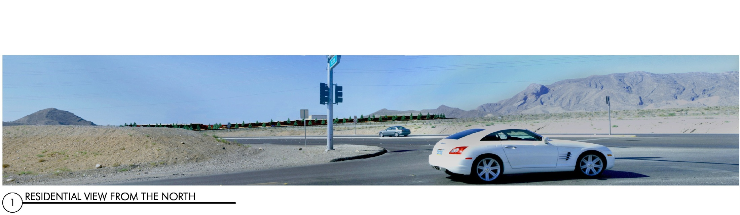
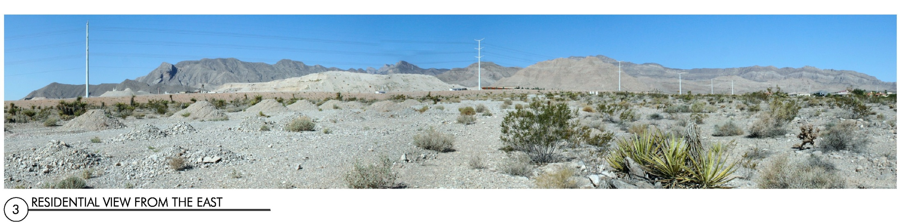
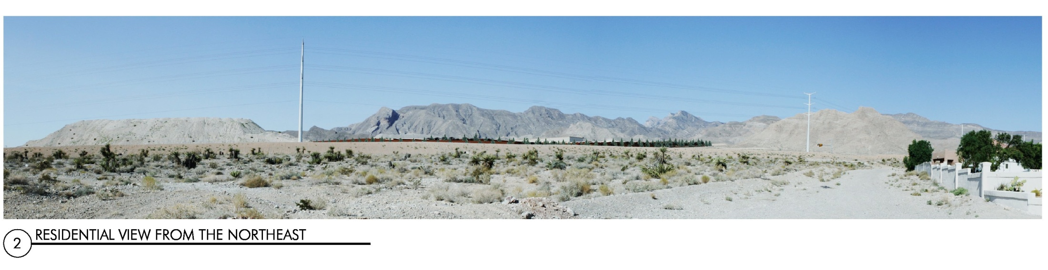
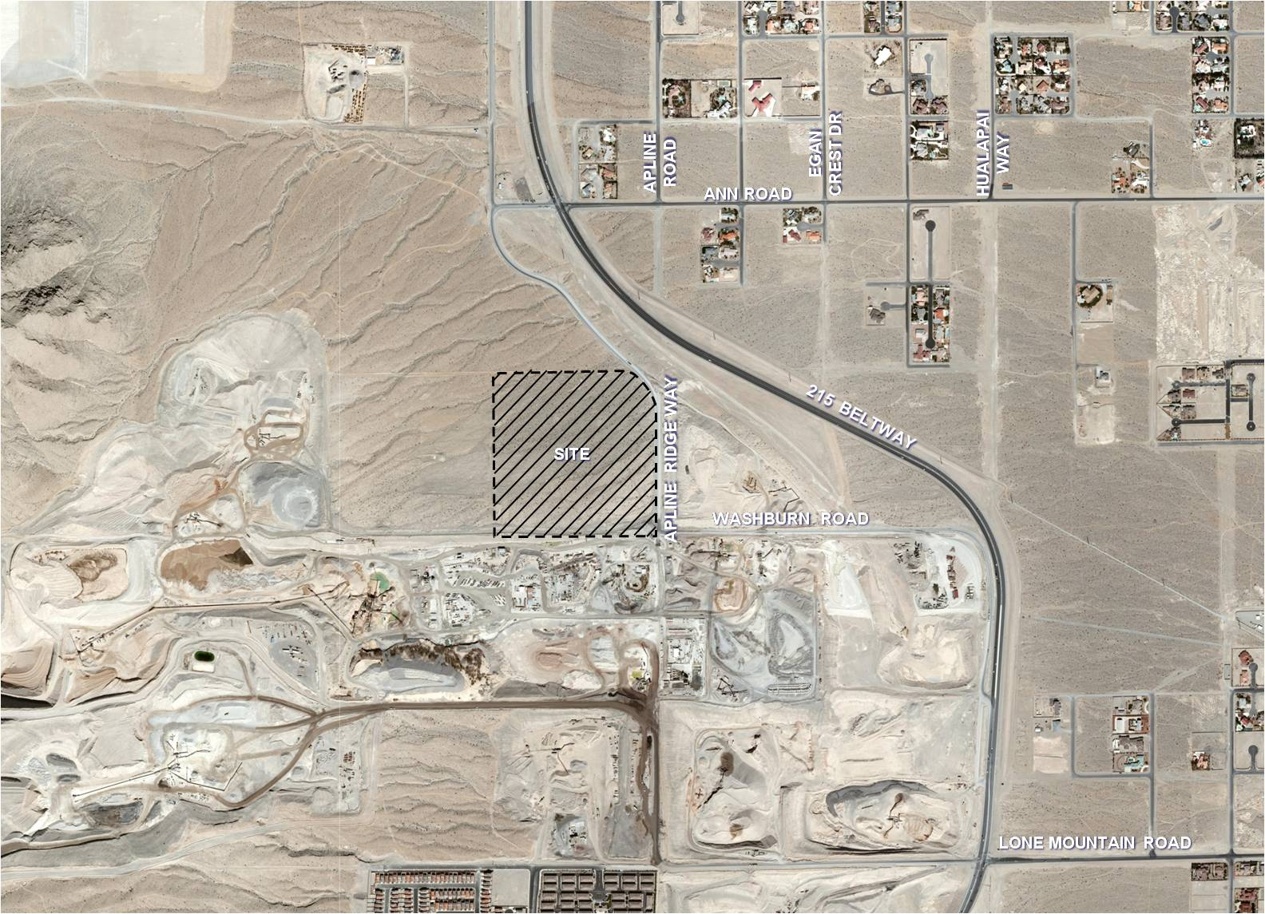
1
2
3
SITE
NORTHWEST SATELLITE TRANSPORTATION FACILITY
RESIDENTIAL SITE VIEWS

Slide 18
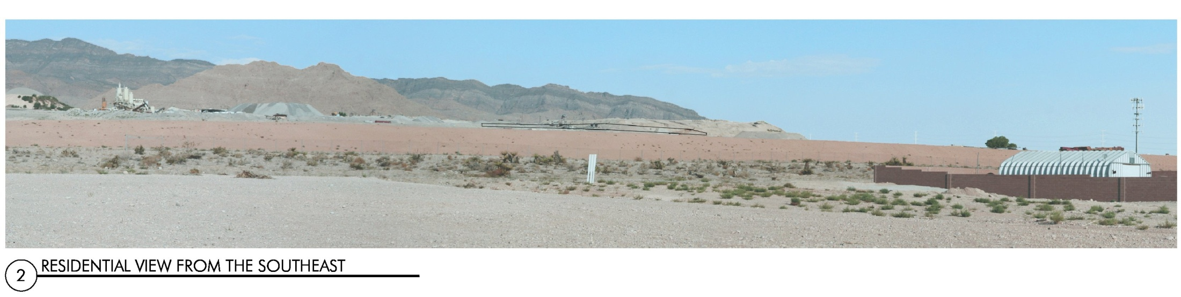
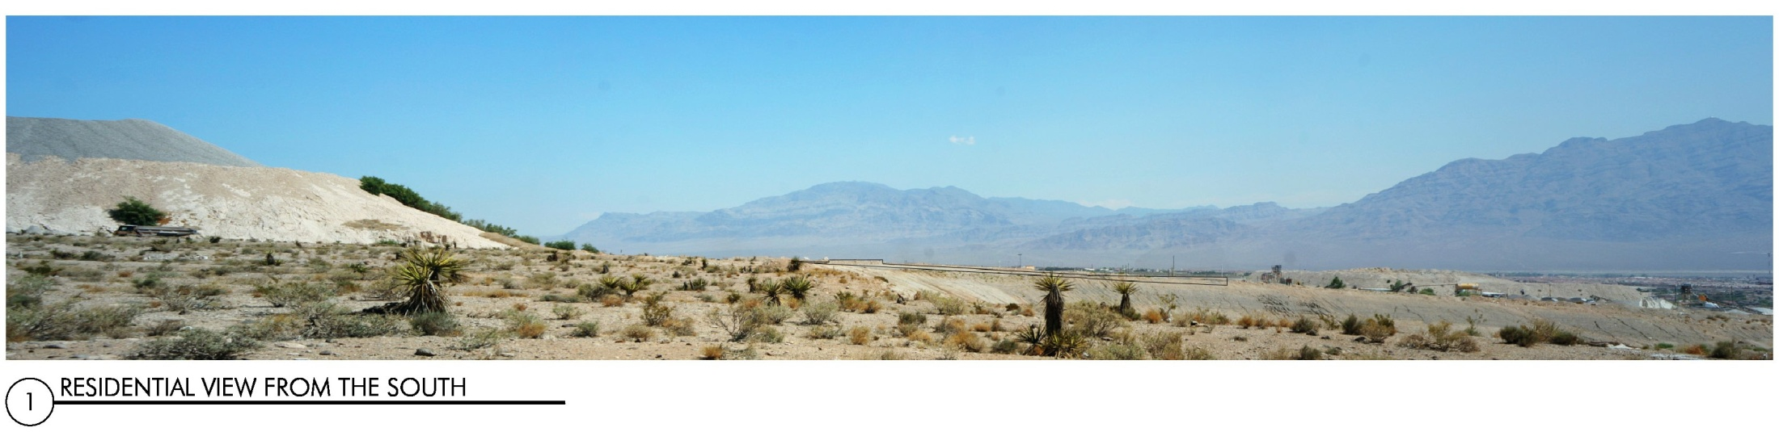
SITE
2
1
NORTHWEST SATELLITE TRANSPORTATION FACILITY
RESIDENTIAL SITE VIEWS

Slide 19
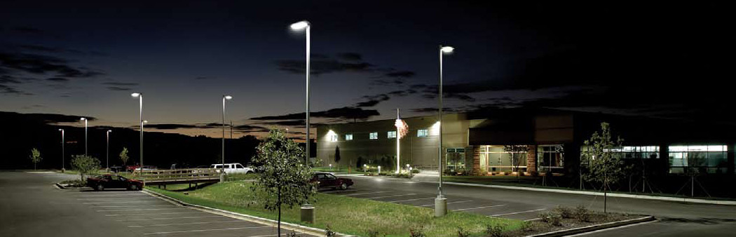
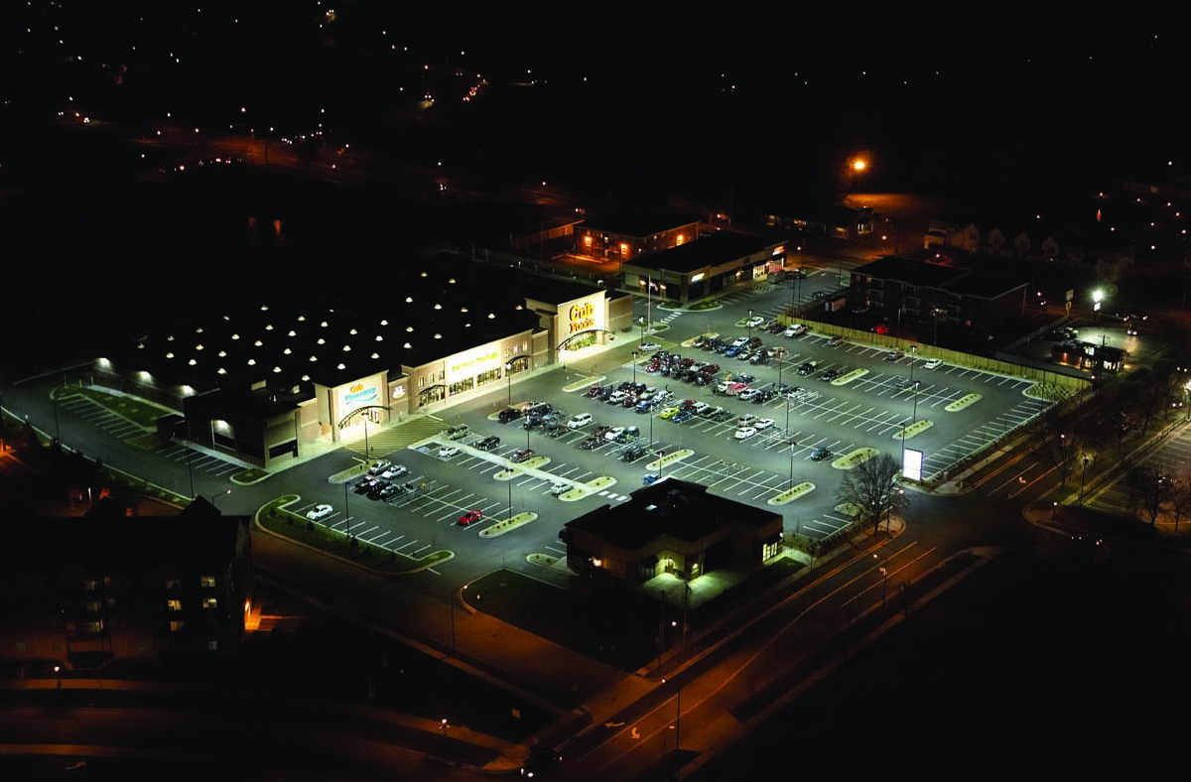
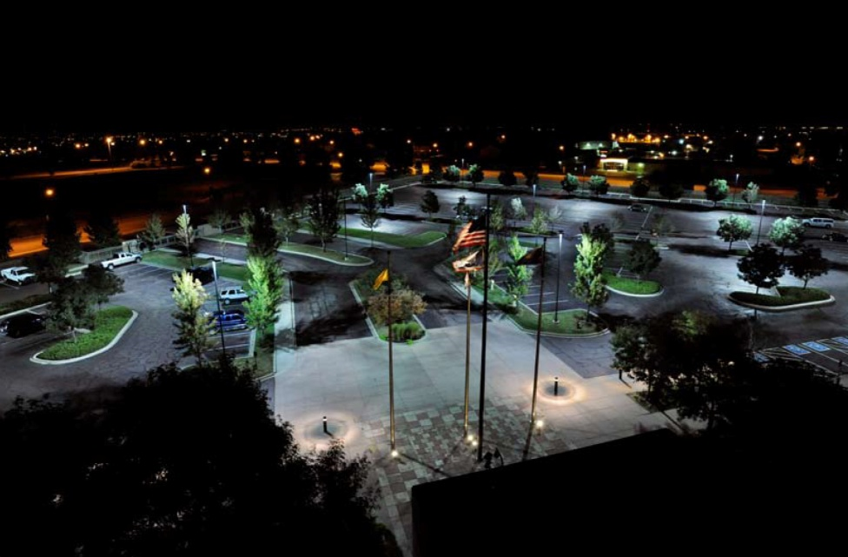
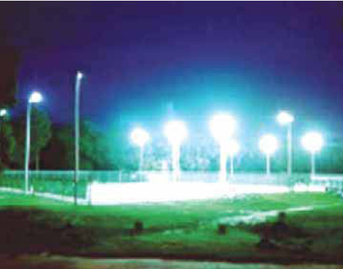
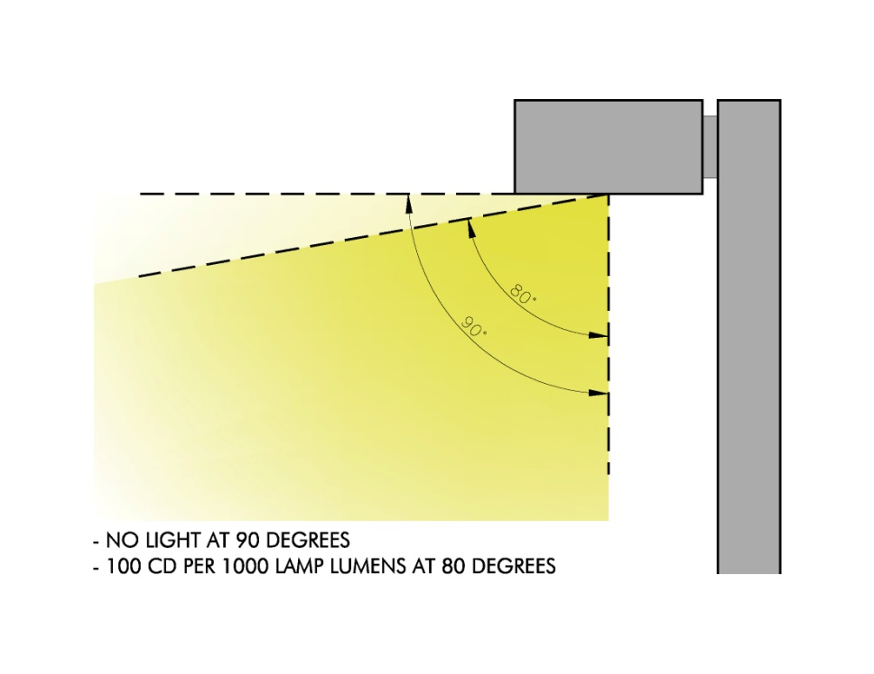
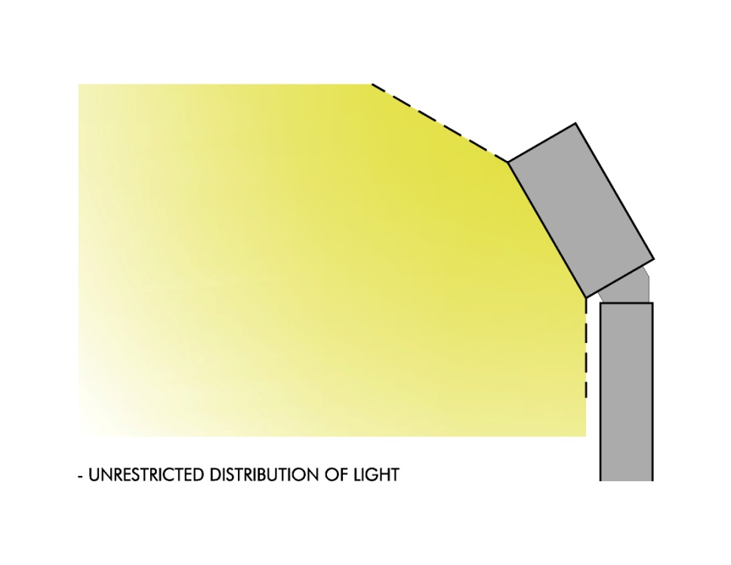
FULL CUTOFF FIXTURES
FULL CUTOFF FIXTURES
FLOODLIGHT FIXTURES
- NO LIGHT AT 90 DEGREES
- 100 CD PER 1000 LAMP LUMENS AT 80 DEGREES
- UNRESTRICTED DISTRIBUTION OF LIGHT
NORTHWEST SATELLITE TRANSPORTATION FACILITY
LIGHTING FIXTURE SELECTION

Slide 20
Engineering
Vernon Harkins, P.E.

Slide 21
Engineering
Ann Road Interchange / Sound Wall
Traffic Study
  Bus Queueing
  Ingress/Egress
  Circulation
Utilities
Amendment to Master Streets and Highways Plan
Slope/Grading
NORTHWEST SATELLITE TRANSPORTATION FACILITY
ENGINEERING

Slide 22
Transportation
Frank C. Giordano

Slide 23
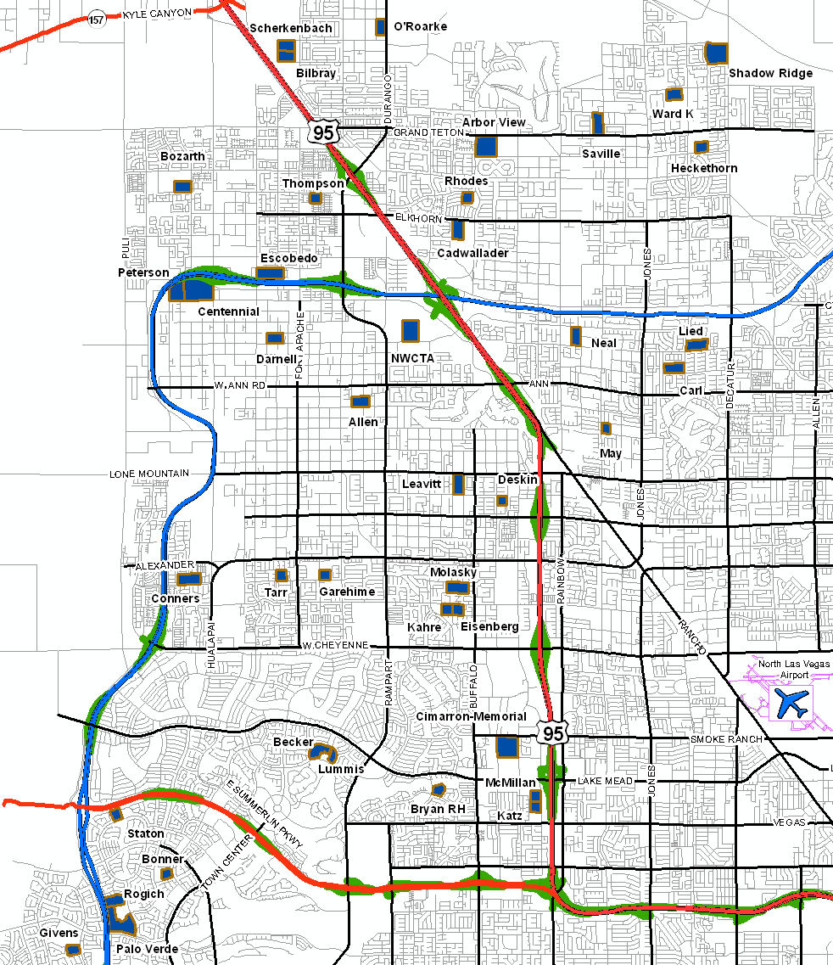


Service and $ Savings
Legend
NW Area Schools
Proposed Bus Yard
Major Highways
Highway Access
County 215
Major Roads
City Streets
Proposed Northwest
Bus Yard
Servicing 43 Northwest Schools
  27 Elementary Schools
  8 Middle Schools
  6 High Schools
  2 Career Technical Schools
Reduce Transportation Costs by 3.3 Million Dollars
  Reduction of 2.4 million miles annually
  Reduction of $900,000 in labor hours annually
No expected change in bus travel within and throughout the area
  Maintain current stops, runs and routes
NORTHWEST SATELLITE TRANSPORTATION FACILITY
PROJECTED BUS TRAVEL FROM FACILITY
Notes:
Need to address

Slide 24
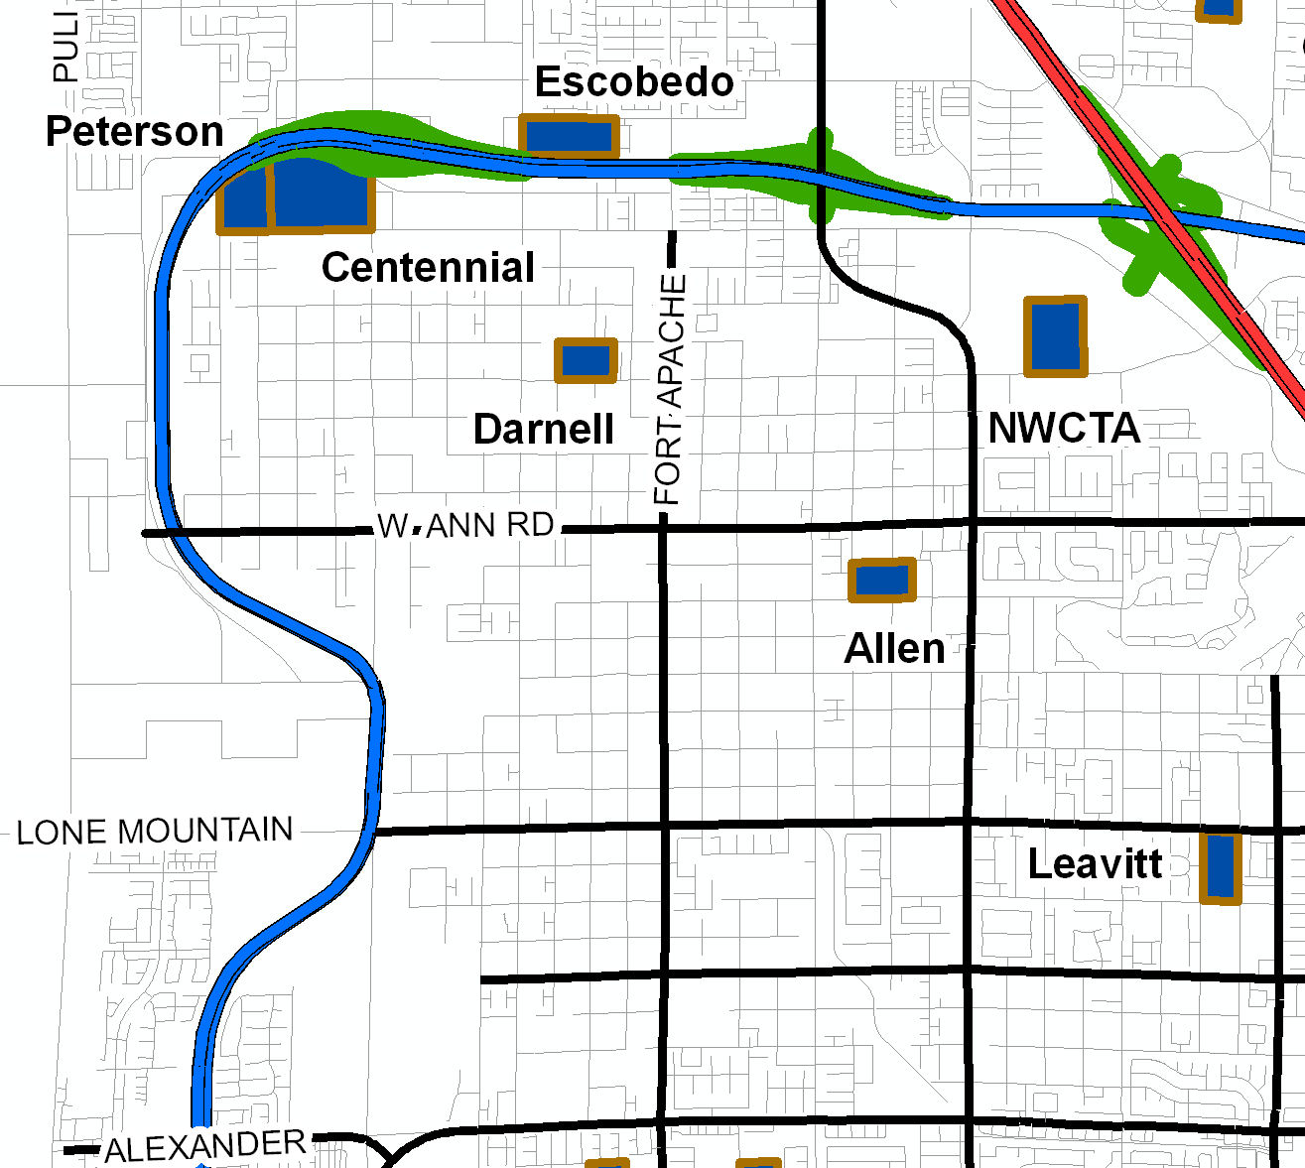


Bus Travel From NW Facility
Legend
NW Area Schools
Proposed Bus Yard
Major Highways
Highway Access
County 215
Major Roads
City Streets
Proposed Northwest
Bus Yard
Bus Travel to/from NW Transportation Facility
  120 buses North bound on I-215
  50 buses East bound on W. Ann Road
  140 buses Southbound on I-215
  Buses will arrive/depart in staggered, incremental times, depending upon stop locations and school bell times.
Continue to provide services to students with special needs
  Addition of buses/routes will only be to accommodate growth as needed
Proposed Northwest
Bus Yard
NORTHWEST SATELLITE TRANSPORTATION FACILITY
PROJECTED BUS TRAVEL FROM FACILITY

Slide 25
Environmental
Clark County School District Pollution Mitigation efforts
  All CCSD buses operate on Biodiesel fuel
  Recently retrofitted 967 buses with Closed Crankcase Ventilation (CCV) systems and Diesel Oxidation Catalysts (DOC)
Concerns over diesel exhaust contamination of surrounding water tables
  Nancy Rumrill, US EPA Environmental Engineer, stated that in her opinion there is no potential for contamination of groundwater from an airborne exhaust source and not a significant potential for contamination from exhaust residue.
  Russ Land, Geologist - Nevada Department of Environmental Protection, concurs with Ms. Rumrill.
Concerns over fuel leakage into groundwater
  The CCSD fuel tanks follow all applicable EPA standards
    Double wall construction
    Electronically monitored for leaks
NORTHWEST SATELLITE TRANSPORTATION FACILITY
ENVIRONMENTAL

Slide 26
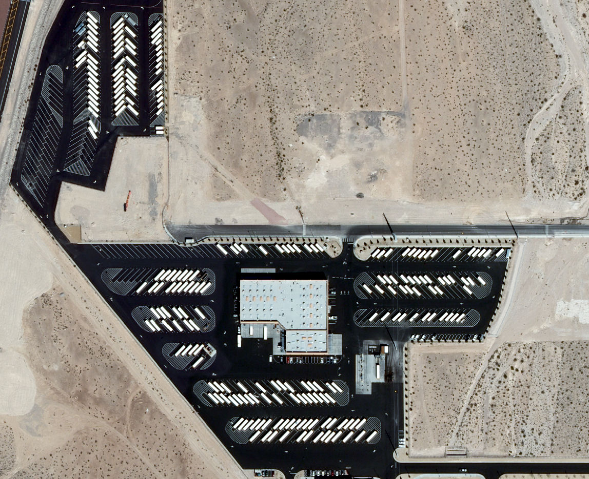
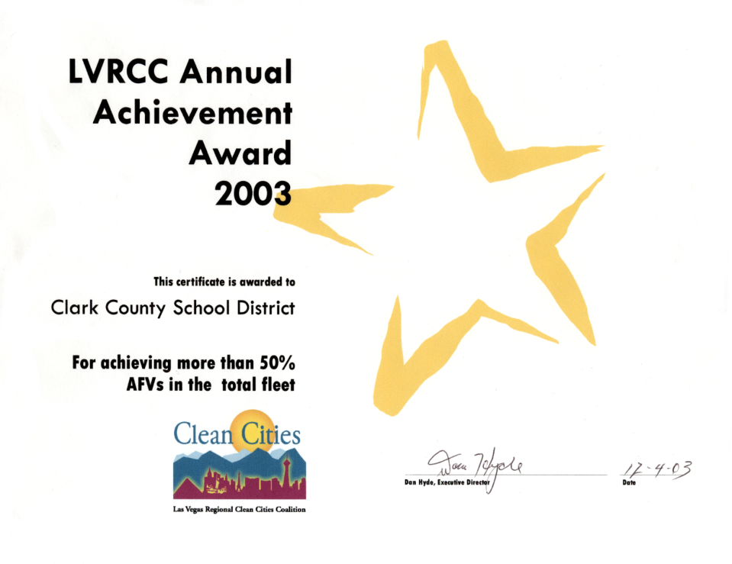


Environmental
Noise level check at the Wallace bus yard on October 23, 2009
Measurements taken 20 feet from
the North gate
Sound pressure level (SPL)
  No Activity = 53 dB(A)
  Maximum SPL = 83 dB(A)
  Individual Bus Avg = 75 to 83 dB(A)
Sound Source (dBA)
Military jet, air raid siren 130
Amplified rock music 110
Jet takeoff at 500 meters 100
Freight train at 30 meters 95
Train horn at 30 meters 90
Heavy truck at 15 meters
Busy city street, loud shout 80
Busy traffic intersection
Highway traffic at 15 meters, train 70
Predominantly industrial area 60
Light car traffic at 15 meters, city or
commercial areas or residential areas close
to industry
Background noise in an office 50
Suburban areas with medium density
transportation
Public library 40
Soft whisper at 5 meters 30
Threshold of hearing 0
Note: A 10 dBA increase in level appears to double the
loudness, and a 10 dBA decrease halves the
apparent loudness.
Source: Cowan, James P. Handbook of Environmental Acoustics.
Van Nostrand Reinhold, New York, 1994. Egan, M. David,
Architectural Acoustics. McGraw-Hill Book Company, 1988.
Wallace Bus Yard
Recipient of the 2003 Clean Cities National Partner Award
from the US Department of Energy for use of Biodiesel
Recipient of the 2009 Clean Air Award from the American Lung Association and the Clark County DAQEM
NORTHWEST SATELLITE TRANSPORTATION FACILITY
ENVIRONMENTAL

Slide 27
Q & A
Linda K. Perri

Slide 28
Additional Information
Website
Next Steps
- http://www.ccsd.net/realproperty
- http://transportation.ccsd.net
Obtain joint concurrence letter from the City of Las Vegas
File with BLM to begin the process for obtaining a lease on the site
Submit entitlements to the City of Las Vegas
NORTHWEST SATELLITE TRANSPORTATION FACILITY
Additional Information

Slide 29
Thank You for Attending
Northwest Satellite Transportation Facility
Neighborhood Meeting
November 19, 2009

Slide 30
Questions ?

Slide 31
Points of Contact
Linda K. Perri
Clark County School District
Director, Real Property Management
lkperri@interact.ccsd.net
(702) 799-5214
Frank C. Giordano
Clark County School District
Director, Transportation
fcgiordano@interact.ccsd.net
(702) 799-6890

