Slide 1
Written Expression Apps
Frannie Williams
Jamie Gunderson

Slide 2
Apps

Slide 3
Reading Apps
Firefly
Read2Go
Overdrive

Slide 4
Firefly
Firefly has recorded literature available and can be searched by grade level.

Slide 5
Firefly

Slide 6
Firefly
Select grade level

Slide 7
Firefly

Slide 8
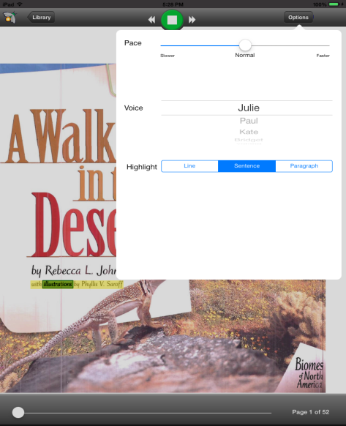
Firefly
Adjust pace, voice and word highlighting

Slide 9
Read2Go
Used to read Bookshare Books

Slide 10
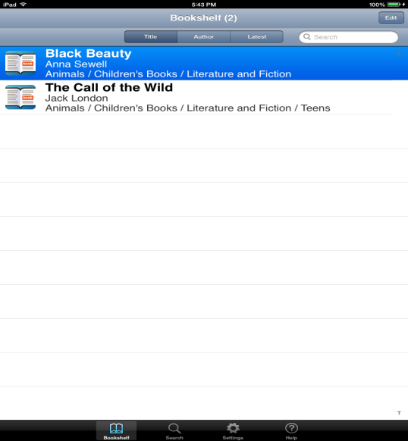
Read2Go
Select book

Slide 11
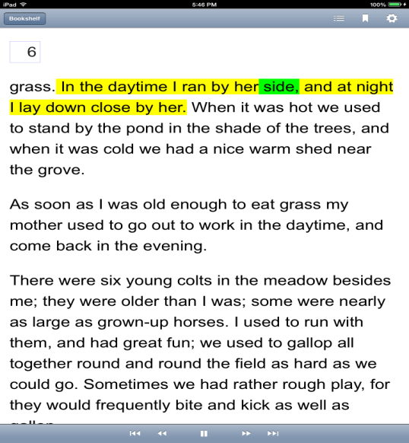
Read2Go
Click play to read / listen to the story

Slide 12
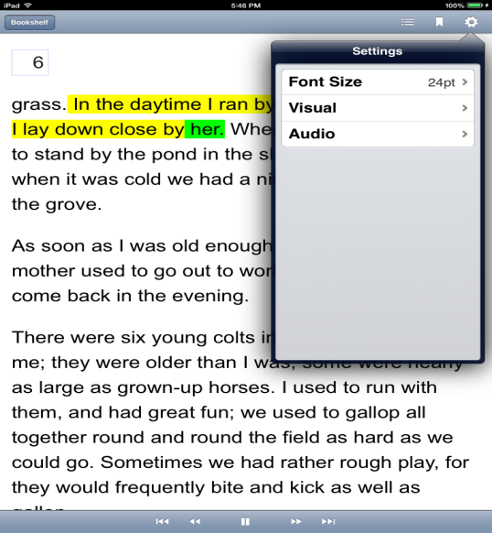
Read2Go
Settings

Slide 13
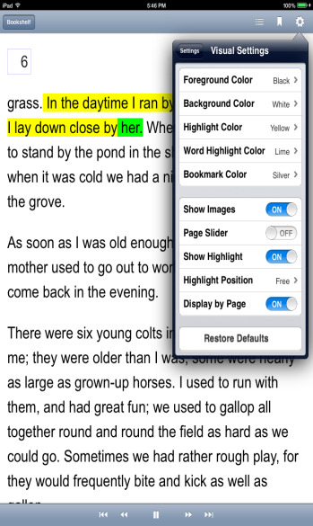
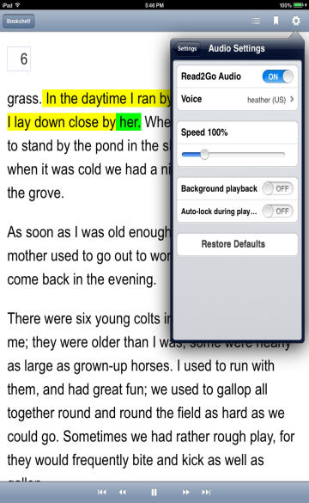
Read2Go
Visual
Audio

Slide 14
OverDrive
Used to read library Books

Slide 15
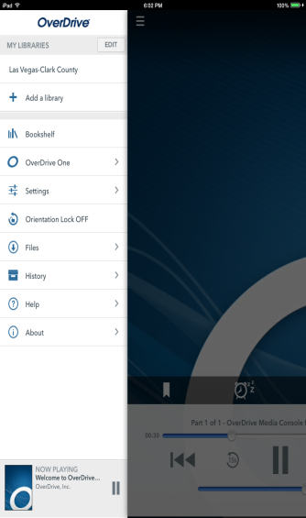
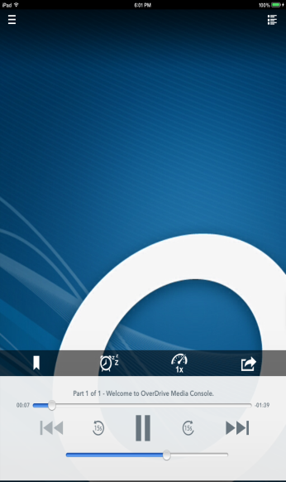
OverDrive
Must set up with library card
Play downloaded audio books from the library

Slide 16
Written Expression Apps
QuickOffice
Typo
Notability
PaperPort Notes
Dragon Dictation

Slide 17
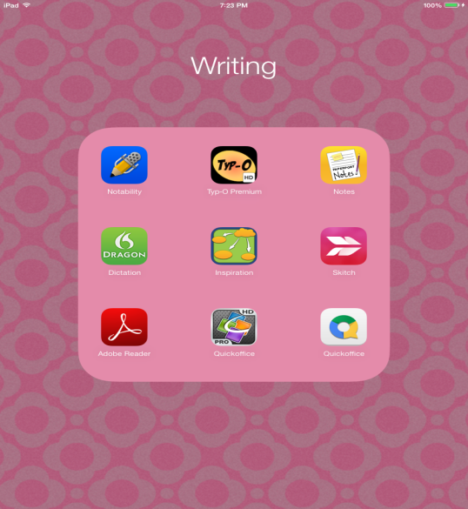
QuickOffice

Slide 18
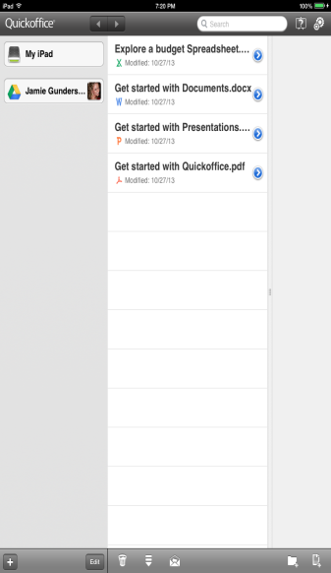
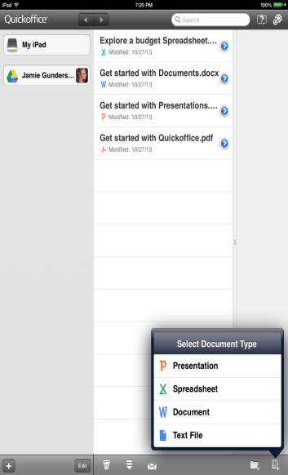
QuickOffice
help
share
Select document type
folder

Slide 19
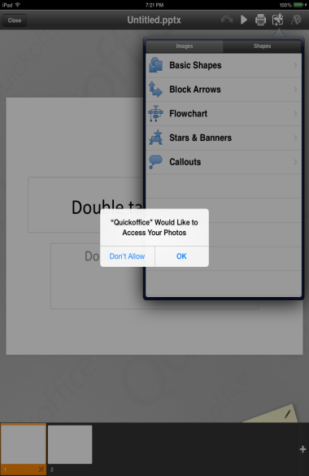
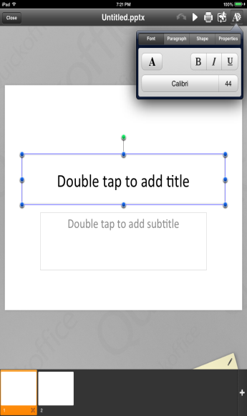
QuickOffice
ok
POWERPOINT

Slide 20
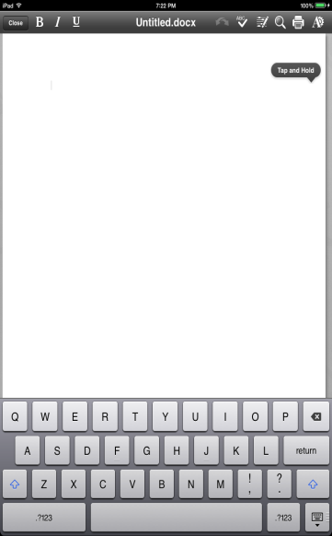
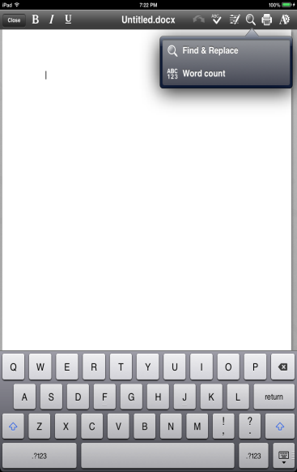
QuickOffice
WORD

Slide 21
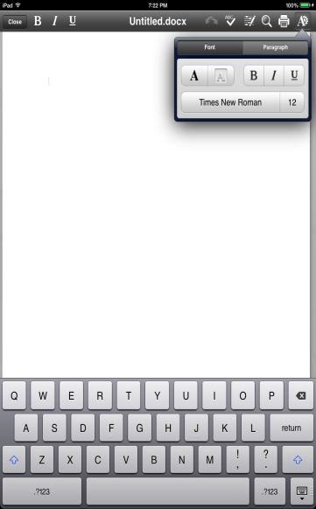
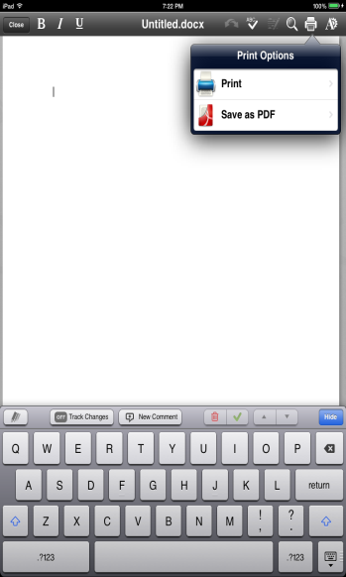
QuickOffice
You will be prompted to save when you hit close

Slide 22
Typo
Word prediction app

Slide 23
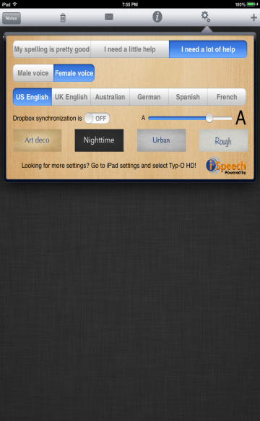
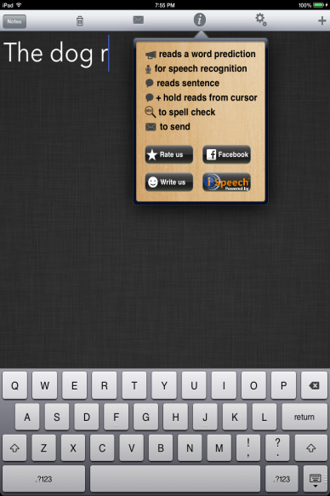
Typo

Slide 24
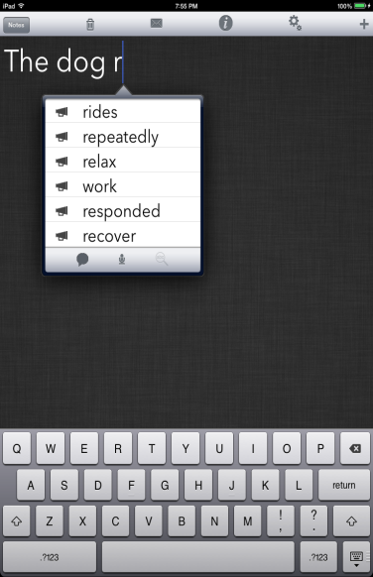
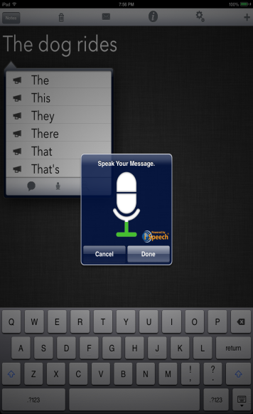
Typo
Save to Dropbox
Select word
speak

Slide 25
Notability
Notability allows you to create & edit documents

Slide 26
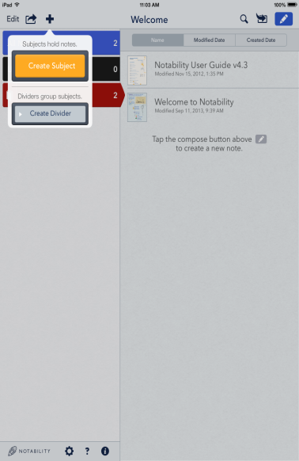
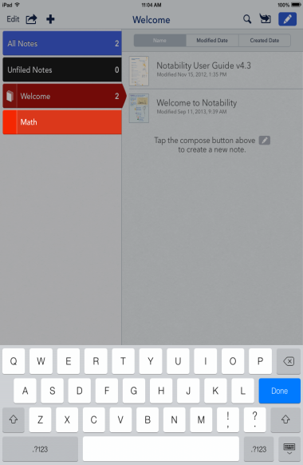
Notability
New Note
Organize subjects

Slide 27
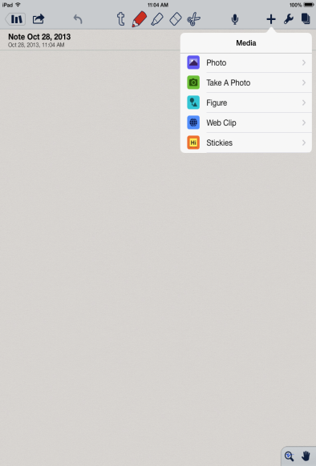
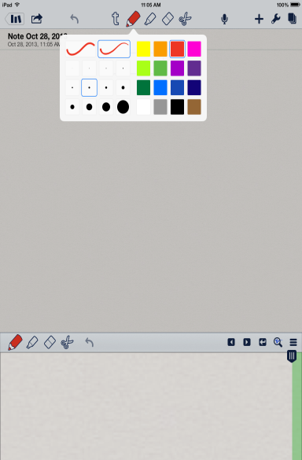
Notability
Hold to select color & thickness
Library
Add media
Zoom signature

Slide 28
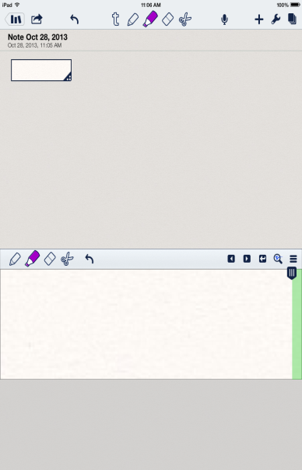
Notability
Zoom signature
To create a text box press finger to screen and lightly hold

Slide 29
PaperPort Notes

Slide 30
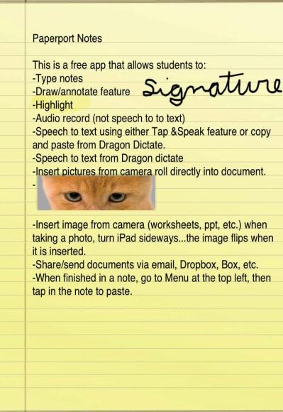
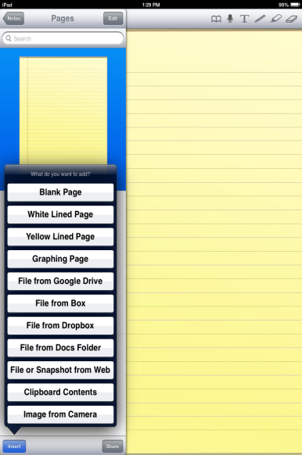
PaperPort Notes
Select paper or image

Slide 31
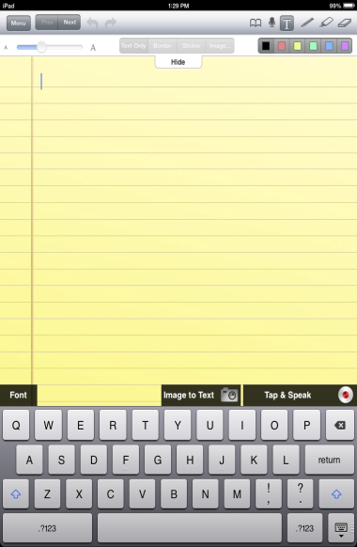
PaperPort Notes
Can write or type

Slide 32
Dragon Dictation

Slide 33
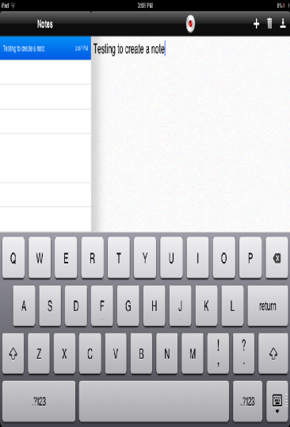
Dragon Dictation
To edit/correct a note
Tap the keyboard symbol
Place cursor and edit
Steps to use Dragon Dictation app
1. Open app
2. Tap red dot on screen to start dictation
3. Limit of 60 seconds
4. Tap screen to end dictation

Slide 34
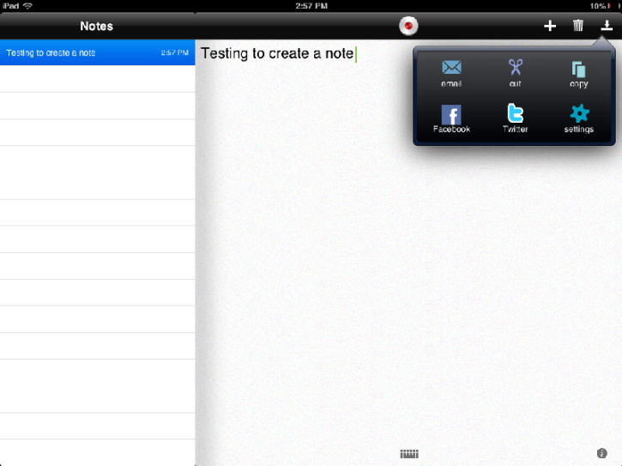
Dragon Dictation
Copy sentence and paste into other apps

Slide 35
Connecting with Students
Dropbox
Solia

Slide 36
Dropbox
upload
Open in app
files

Slide 37
Solia

Slide 38
Academic Websites

Slide 39
Academic Websites
Readibility
Text Compactor
Simple Wikipedia
Google Advanced Reading Level Search
Notes:
Live links to each website!

Slide 40
Academic App Websites

Slide 41
Academic App Websites
Appitic
Graphite
Mind Leap
Teachers with Apps
Fun Educational Apps
Notes:
Live Links!

Slide 42
Assistive Technology Website
http://ccsd.net/departments/assistive-technology-services
Notes:
Live link!

